Slide 1
Probability and Venn Diagrams
4.1

Slide 2
Learning Goals and Success Criteria
Learning Goal: To be able to represent and solve probability questions using Venn Diagrams
Success Criteria:
I can make venn diagrams representing situations with P (AnB) scenarios
I can represent mutually and non-mutually exclusive events
I can make venn diagrams representing situations with P (AuB) scenarios
I can represent independent and dependent events
I can solve problems with three events using Venn diagrams

Slide 3
Draw a Venn Diagram
What is a venn diagram?
How can we use venn diagrams?

Slide 4
Whole Class: do you play sports and/or like rap music?
What is the probability of randomly choosing a student who likes rap music and plays a sport?

Slide 5
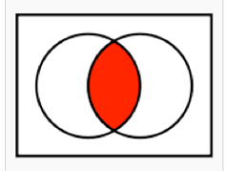
P (AnB): AND probabilities
Independent Events: When the occurrence of one event does not affect the occurrence of the other
P (AnB) = P (A) * P (B)
Dependent Events: When the occurrence of one event does affect the occurrence of the other
P (AnB) = P (A) * P (B), where P (B) is adjusted based on the results of event A.
Remember, if it’s n (AND), only shade in what OVERLAPS

Slide 6
Yes or No: Are these Events Independent?
Drawing a green marble and a coin landing on heads
Grabbing a kiwi from a bowl of fruit and then grabbing a second kiwi from the same bowl
Rolling a 4 and then rolling a second 4 on the same die

Slide 7
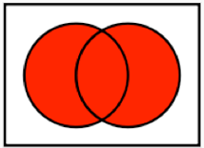
P (AuB) : OR Probabilities
Mutually Exclusive: When the two events cannot happen at the same time
P (AuB) = P (A) + P (B), P (AnB) is zero in this case
Non-Mutually Exclusive: When the two events can happen at the same time
P (AuB) = P (A) + P (B) - P (AnB)
Remember, if its u (OR), shade in everything that works!

Slide 8
Yes or No: Are these events mutually exclusive?
Having blue eyes, having brown hair
Picking a red card, picking a clubs
Taller than 1.5 m, taller than 1.7m
Born in june, born in the winter

Slide 9
Practice
A person flips a coin and rolls a die.
Event (A): flipping a tails
Event (B): rolling a 4
Draw a Venn diagram representing this situation
Shade in the area of the venn diagram representing the probability of event A and B occurring
What is the probability of event A and B occurring?

Slide 10
Three Circle Venn Diagram
AnB
A
B
AnBnC
AnC
BnC
C

Slide 11
Practice
Textbook, p. 93, # 4 - whole - class
Individually / with partners: #9

