Slide 1
Chemistry
Uncertainty & Sig. figs.
Appendix 5
“Quantum Chemistry”

Slide 2
Notes! Please write!
Significant Figures (or digits):
They are a guide to how much we should round off a calculated answer.
This is useful when you are doing calculation problems where the uncertainty is not provided, but instead needs to be inferred by the #s given!

Slide 3
Notes! Please write!
Rules for Significant Figures :
All non-zero digits are ALWAYS significant
Zeros between significant digits are ALWAYS significant.
Zeros at the beginning of a number are NEVER significant.
Zeros at the end of a number MAY be significant.
Exponents, multiples, bases, etc. are NEVER significant.

Slide 4
Examples of Rule 1, 2 and 3
Rule 1. Non-zero digits are ALWAYS significant.
1.234 has 4 significant digits
145 has 3 significant digits
19567.2 has 6 significant digits
Rule 2. Zeros between significant digits ARE significant.
has 4 significant digits
5007.4 has 5 significant digits
20000.6 has 6 significant digits
Rule 3. Zeros at the beginning are NEVER significant.
007 has 1 significant digit
0.0000005 has 1 significant digit
0.025 has 2 significant digits

Slide 5
Explaining Rule 4
Rule 4. Zeros at the end of a number MAY be significant.
If there is a decimal point, there is no problem. All textbooks agree, the zeros are ALL significant.
3.00000 has 6 significant digits
5.10 has 3 significant digits
10.00 has 4 significant digits
If there is NO decimal, the situation is ambiguous, and a bit of a JUDGEMENT CALL. If you trust the source to be precise, then you count all the zeros at the end. If you have reason to believe the person was estimating, then you don’t count the zeros at the end.
5000 has 1 to 4 significant digits
250 has 2 or 3 significant figures
123 000 000 has 3 to 9 significant figures
In science we should write the #s in scientific notation.
Only significant #s are written!
For this class ….
You can assume all #s in a problem are significant.
In a test situation, assume the numbers are precise, unless stated otherwise.
Estimated source
Trusted precise source

Slide 6
Rule 5
Rule 5: Exponents and their bases, perfect multiples, are NEVER significant.
6.02 x 10²³ has 3 significant digits
504.1 mL x 3 has 4 significant digits (the 3 is not measured)
5.3 ±0.5 mL has 2 significant digits
– 5.432 x 10⁻⁵ has 4 significant digits
π x 3.54 cm has 3 significant digits (π is not a measurement)
In each case,
the blue part is significant, the green part is NOT significant.

Slide 7
Notes! Add examples!
Rules for Significant Figures :
All non-zero digits are ALWAYS significant
Zeros between significant digits are ALWAYS significant.
Zeros at the beginning of a number are NEVER significant.
Zeros at the end of a number MAY be significant.
Exponents, multiples, signs, absolute errors etc. are NEVER significant.
21 =
2 sig. figs
4 sig. figs
2001 =
1 sig. fig.
0.04 =
3 sig. figs
21.0 =
7

Slide 8
Maths with Significant Figures
Adding and Subtracting:
All units must be the same (can’t add different units!)
Line up all the measurements at their decimal points.
Add or subtract as normal.
Round off all numbers to match the shortest number of decimals.
Decimals lined up
Round off
Example: add the following measurements.
5.34576 L
5345.7 6 mL
This unit is not the same as the others!
(litres vs. millilitres)
55.1 43mL
55.1 43mL
547.1 mL
547.1 mL
5948.0 03 mL
The answer is 5948.0 mL. Note that the answer has 5 sig. digits, even though one of the measurements had only 4 sig. digits. .

Slide 9
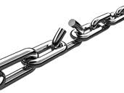
Multiplication and Division:
Different units may be multiplied or divided if there is a formula to justify it.
The main rule in multiplying and dividing is that you cannot have an answer with more significant digits than your “weakest” measurement (the one with fewest significant digits)
After doing the math, round off your answer to match the weakest measurement.
Weakest measurement only 3 Sig.Figs.
You are the weakest link. Goodbye!
Multiply 2.53 by 75.35
2.53 x 75.35 = 190.6355
=191
Answer has 3 Sig.Figs.

Slide 10
Math with Significant Figures
Perfect numbers
Double a quantity → the 2 you multiply by is considered perfect.
Mole ratios in stoichiometry
π
Mixed operations
Follow BEDMAS

Slide 11
Notes! Please write!
Adding and Subtracting:
All units must be the same (can’t add different units!)
Line up all the measurements at their decimal points.
Add or subtract as normal.
Round off all numbers to match the fewest # of decimals.
Multiplication and Division:
After doing the math, round off your answer to match the lowest # of sig.figs.
Combination
Follow BEDMAS

Slide 12
Problems on Significant Figures
How many significant digits are in each measurement:
123.45 mL c) 7 apples e) 0.0023 m
4.500 x10³ mL d) times 5 f) 4000 kg
A Coulter counter is a device which counts the blood cells in a sample as they pass through a beam of light. A laboratory technician records 20000 wbc in a blood sample. At a demonstration a reporter says there were 20000 protesters. Both numbers are the same, which one has more significant figures? Why?
Find the volume of a cube that measures 2.3 cm by 3.55 cm by 2.14159 cm.
Add the measurements: 2.500 kg, 354.2 g, 153.78 g
Also: Do the worksheet entitled “Significant Figures”

Slide 13
Density of some metals
Metal | Density (g/cm³)
Aluminum | 2.70
Copper | 8.95
Gold | 19.3
Iron | 7.87
Lead | 11.3
Magnesium | 1.74
Silver | 10.5
Tin | 7.26
zinc | 7.14

Slide 14
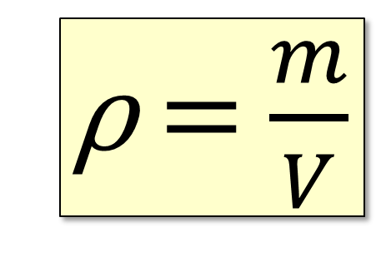
Density
Density is the volume/mass relationship of an object.
X
ρ V
ρ = $\frac{m}{V}$
m
or
Where: ρ = the density of the object, in g/cm³ or g/mL
m = the mass of the object, in g
V = the volume of the object, in cm³ or mL
ρ_{w} = 1 ^{g}/_{mL} = 1 ^{g}/_{cm}³
The density of water is 1 g/mL.
This is not true of other substances.
Objects with less density than water will float. Objects with greater density will sink.

Slide 15
Solving Problems
When solving Chemistry problems on a test or exam, it is important not only to find the correct answer, but to justify it.
Show your data,
Show your work, including the formulas you used and the substitutions you made.
Write an answer statement, a sentence that clearly states your final answer.
Include the correct units for your answer. Never just give a number—you must specify what the number means!

Slide 16
Suggested Solution Method
Problem: A block of material has a length of 12.0 cm, a width of 5.0 cm, and a height of 2.0 cm. Its mass is 50.0 g.
Find its density.
List all the information you find in the problem, complete with units, and the symbols.
Data:
l = 12 cm.
w = 5.0 cm
h =2.0 cm
m =50g
V = ?
To Find: ρ (density)
Show the substitutions you make, and enough of your calculations to justify your solution:
Calculations:
V = lwh
=12cm x 5cm x 2 cm
= 120 cm³
𝜌 = $\frac{m}{V}$
=50 g / 120 cm³
= 0.42 g/cm³
Answer: The density of the block is 0.42 g/cm³.

Slide 17
Overview: Uncertainty The Inherent Errors of Instruments
App.5
Page 394
All measurements are made using instruments, and all instruments have imperfections that limit their precision.
This is often called the “error” or “uncertainty” of the instrument.
This is not a mistake made by the observer, but rather an unavoidable reality of an imperfect world.
When we make measurements you must record the error/uncertainty involved.

Slide 18
Absolute Uncertainty (AU)
In math:
they all represent perfect number 2.
2 mL
2.0 mL
2.00 mL
In science:
they all have a different degree of of uncertainty.
All instruments that we use to make measurements have an inherent error or absolute uncertainty.

Slide 19
Notes! Please write!
Absolute uncertainty (AU)
is the error range of an instrument. Unless stated otherwise we will assume it is ½ the measure between the smallest markings.
eg. (32.5 + 0.5) mL
The 0.5 tells you that you must read the measurement to one decimal place.

Slide 20
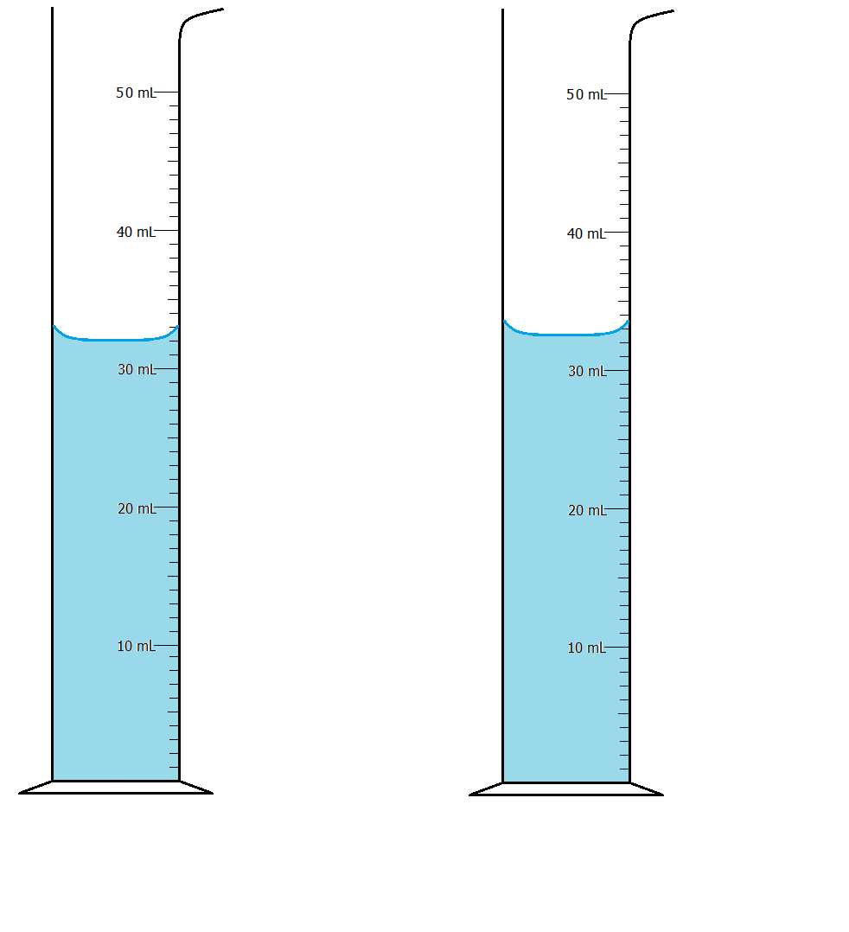
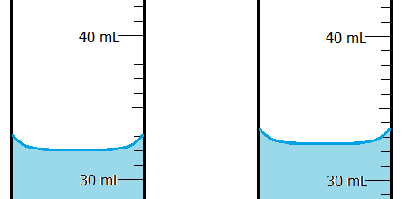
Example of Uncertainty.
At first glance, the two graduated cylinders here seem identical, but look closer.
The first one has a measurement of 32.0 ± 0.5 mL
The second one 32.5 ± 0.5 mL
It is NOT correct to say that the first measurement is just 32 mL!

Slide 21
How to Record Absolute Uncertainty
Plus-minus sign
Unit
( )
32
.5
±0.5
mL
Doubtful, but Significant digit
Absolute Uncertainty
First determine the AU by finding ½ the measure between the smallest marking.
Read the cylinder, you see it is about halfway between 32 and 33 mL, so you record the .5
The AU dictates how many decimal places to leave.
Include units.

Slide 22
Adding & Subtracting with Absolute Uncertainties
Frequently we make two measurements and subtract them to find a difference (Δ).
When we subtract numbers that have an uncertainty we must ADD the absolute uncertainty values!
The volume changes from (20.5±0.5)mL to (24.0±0.5)mL.
AU_{T} = ΣAU or AU_{T} = AU₁ +AU₂+…
The volume difference (ΔV) is (3.5±1.0)mL but because the uncertainty is larger we write (4 ± 1)mL.

Slide 23
Notes! Please write!
Absolute uncertainty (AU)
is the allowable error of the instrument. Unless stated otherwise we will assume it is ½ the measure between the smallest markings.
eg. (32.5 + 0.5) mL
The 0.5 tells you that you must read the measurement to one decimal place.
When adding or subtracting #s with uncertainties, we must add the uncertainties.
Eg.(24.0 ± 0.5)mL –(20.5 ± 0.5)mL =
(3.5 ± 1.0)mL
= (4 ± 1)mL
The AU is always rounded to one significant digit!

Slide 24
Example of Relative Uncertainty
The graduated cylinder has a reading of (32.5±0.5) mL
To find its relative uncertainty, divide:
0.5 ÷ 32.5 = 0.01538461 or 1.5%
relative uncertainties it that they show you how small your error actually is.

Slide 25
Notes! Please write!
Relative uncertainty (RU)
RU of a measurement equals the absolute uncertainty divided by the absolute value of the original measurement.
eg. 32.5 + 0.5 mL
RU = 0.5/32.5 = 0.0153846... Or 1.5%
The RU allows you to determine the AU after a calculation involving multiplication or division.
$$RU=\frac{AU}{\left|measurement\right|}$$

Slide 26
Notes! Please write!
Density example: (58.3±0.9)g ÷ (32.5±0.5)mL.
Ρ = m δP = (δm + δV) P
V m V
= 58.3g
32.5mL
= (0.9 + 0.5) x 1.79385
58.3 32.5
Ρ = 1.79385 g/mL
δP = 0.0552901 round to one significant digit
(keep 4-6 digits!)
δP = 0.06
Therefore you must round to two decimal places!
Final answer: (1.79 + 0.06) g/mL

Slide 27
Uncertainty Formulas
Please
write!
Adding or subtracting: add the uncertainties
$$\text{(}\text{A}+B) ±(\text{δ}\text{A}+\text{δ}\text{B}\text{)}$$
$$\text{(}\text{A}−B) ±(\text{δ}\text{A}+\text{δ}\text{B}\text{)}$$
Multiplying or dividing: add the relative uncertainties x the solution
$\text{δ}\text{AB}$ = $\left(\frac{\text{δ}\text{A}}{A}+\frac{\text{δ}\text{B}}{B}\right)AB$
$\text{δ}\text{(}\frac{\text{A}}{B})$= $\left(\frac{\text{δ}\text{A}}{A}+\frac{\text{δ}\text{B}}{B}\right)\frac{A}{B}$
Combination question:
follow bedmas, no rounding until the very end!

