Slide 1
Chapter 1 The Organization of Matter
Related concepts: particles, atoms, molecules,

Slide 2
Lesson 1.1
Matter, ENERGY and the Particle Model

Slide 3
Matter
Matter is anything that has mass and volume.
Matter is made up of atoms.
Mass means that it weighs something on Earth. Mass does not change, weight does (weight is influenced by gravity).
Be careful though, some things are so light we may think they have no weight, but they do!
Mass is usually measured in International System (kg)
1000 g = 1 kg, 1000 kg = 1 tonne
Volume means that it takes up space.
Some things can expand and contract, but still take up space
Volume is usually measured in millilitres (mL) or litres (L)
1000 ml = 1 L

Slide 4
Careful!
Solids and liquids are obviously made of matter.
They have easy-to-measure volume and mass
But so are gases!
Their mass is very low, so we often can’t measure it… It’s difficult, but not impossible, to weigh air!
Their volume can change easily, so it is difficult to measure the volume of a gas.

Slide 5
Solids, Gases, and Liquids are made of matter
Everything is made up of matter

Slide 6
There is an exception…
ENERGY…
is NOT matter;
is the ability to do work;
is measured in joules (J);
can neither be created nor destroyed;
can be transferred into another form of energy.

Slide 7
Types of Energy
Mechanical Energy (Potential and Kinetic Energy),
Electromagnetic Energy (related to light and other waves),
Nuclear Energy (Nuclear Fission and Nuclear Fusion),
Electrical Energy (related to electrical charges),
Thermal Energy (heat),
Chemical Energy (energy stored in chemical substances).

Slide 9
The Particle Model
A scientific model that states:
“All matter is made of tiny particles”
The tiny particles include:
ATOMS and MOLECULES
O
O
O
C
Oxygen molecule
(O₂)
Carbon monoxide molecule
(CO)
H
H
S
Hydrogen molecule
(H₂)
C
S
O
S
H
Carbon atom
O
Sulfur atom
H
H
Hydrogen atom
Sulfur molecule
(S₈)
Oxygen atom
Water molecule
(H₂O)

Slide 10
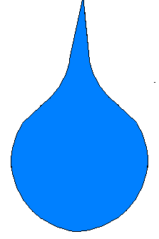
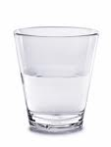
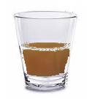
How can matter be classified?
There are many ways to describe or classify matter:
By its phase or State.
By its Composition.
By its Properties
Gas
Solid
Liquid
Pure vs. Mixture
(Elements – Compounds) – (Solutions - Colloids – Suspensions)
Density, melting/freezing point, boiling point, conductivity, other characteristics

Slide 11
What are the phases or states of matter?
Solid
Gas
Gas
Liquid
The particles are close together.
Fairly Strong Attraction
( a bit weaker than solid)
,(much stronger than gas)
Some freedom to move.
The particles are close together
Very Strong Attraction
Little freedom to move
The particles are far apart
Little or no attraction
Lots of freedom of movement

Slide 12
Summary Chart of Different Phases
State | Forces of Attraction of particles | Distance between Particles | Freedom of Movement of particles | Shape (definite or indefinite) | Volume (definite or indefinite
SOLID | Very Strong The bonds in a solid prevent the molecules from moving freely. | Close Together | Very Little Freedom of movement (the particles can vibrate) | Definite A solid keeps shape, even when you move it around | Definite A solid keeps its volume, even when you move it around.
LIQUID | Fairly Strong Slightly weaker than a solid, but strong enough to keep the liquid together. | Close together | Some Freedom of movement (particles slide & rotate) | Indefinite Liquids take the shape of their container, but they may not fill it to the top. | Definite Liquids keeps their volume, even if you pour them into a new container.
GAS | None (or very weak) The lack of bonds lets the molecules move anywhere | Far Apart | Lots of Freedom of movement (particles move anywhere) | Indefinite A gas takes the shape of its container, and fills it completely. | Indefinite A gas fills its container completely, changing its volume to do so.

Slide 13
Classification:
Everything that has a mass and volume is “matter”
Matter can also be classified this way:
Matter
Pure Substances
Mixtures
Mixtures can be
physically separated
Element
compounds can be
chemically separated
Compound
Homo-geneous Mixture
Hetero-geneous Mixture
Gold
one of 118 atoms of the periodic table
Water
or any of thousands of compounds
Solution
Colloid
or emulsion
Suspension

Slide 14
Lesson 1.2 MIXTURES
A mixture contains at least two different substances.
Mixtures are not pure substances.

Slide 15
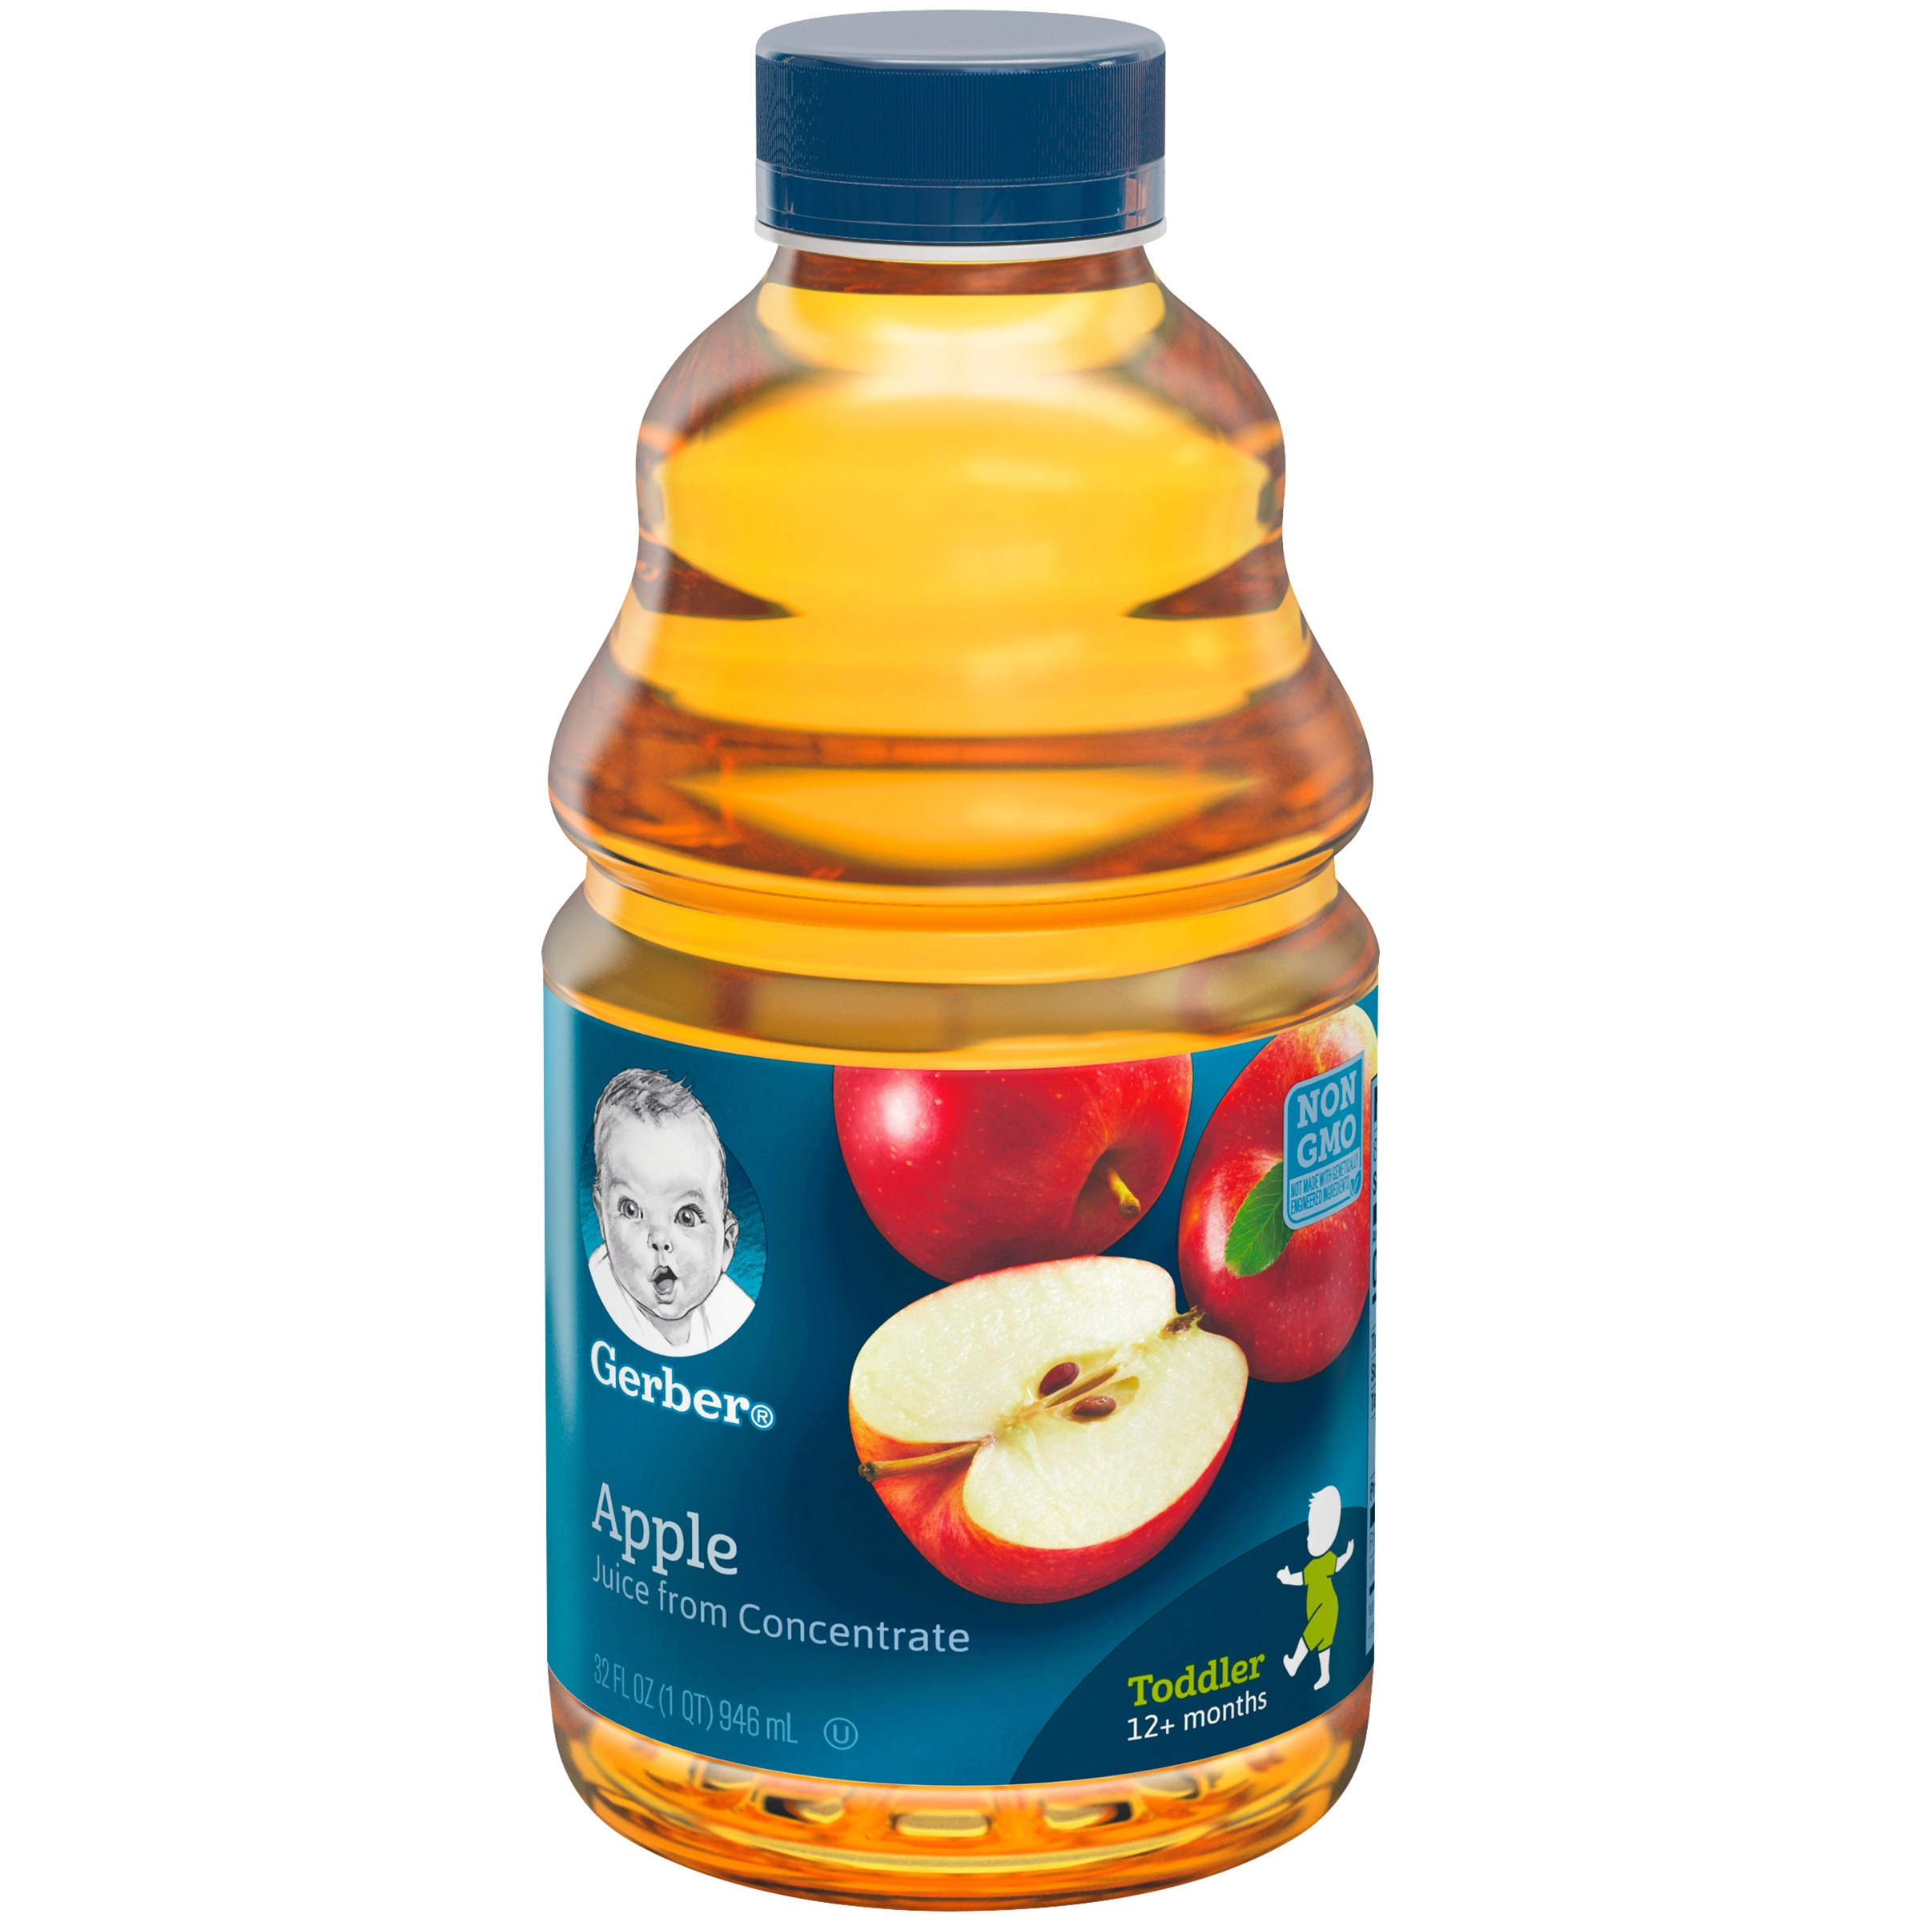
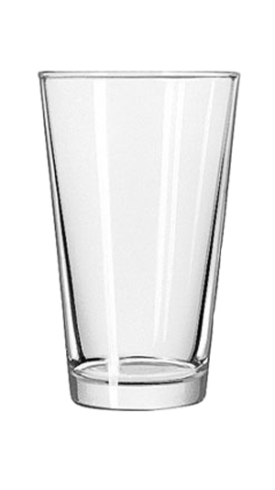
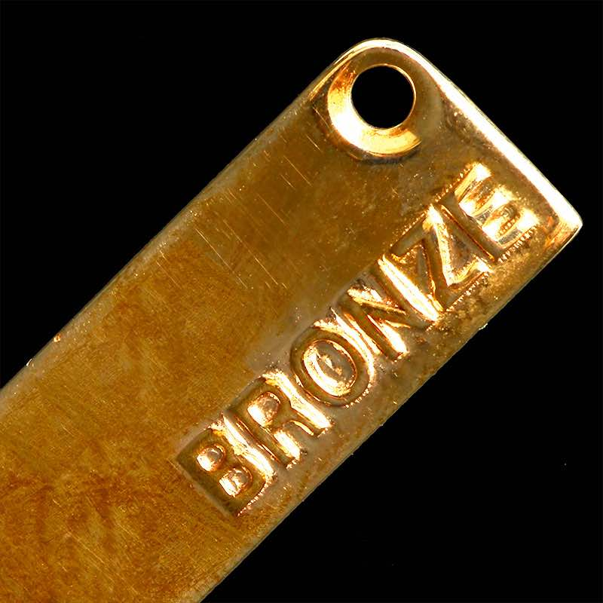
Homogeneous Mixtures
Homogeneous mixtures (solutions, colloids and emulsions) are evenly mixed.
If they are liquid mixtures they are usually transparent and don’t settle. If they are solid mixtures they may be transparent, translucent, opaque, or metallic.
Examples: apple juice, Kool-Aid, sugar water, glass, bronze, air

Slide 16
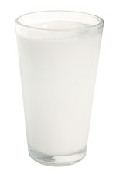
COLLOIDS & EMULSIONS (the “nearly homogeneous” mixtures)
Colloids & emulsions appear homogeneous to the naked eye, but under a microscope the separate particles can be seen.
Colloids tend to look like jelly or mucilage (glue). They are thick, nearly clear liquids that can form semi-solid gels or pastes.
Emulsions tend to look milky. Homogenized milk is an example of an emulsion, so is paint,

Slide 17
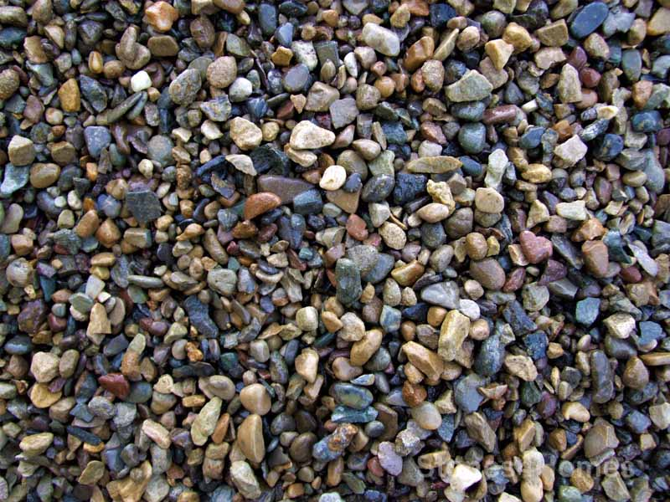
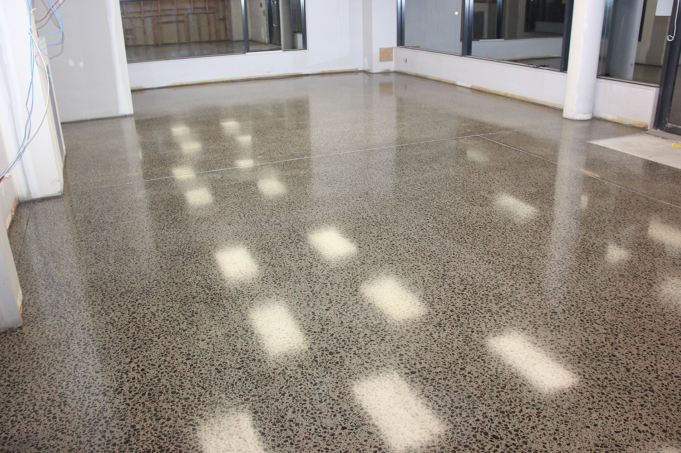
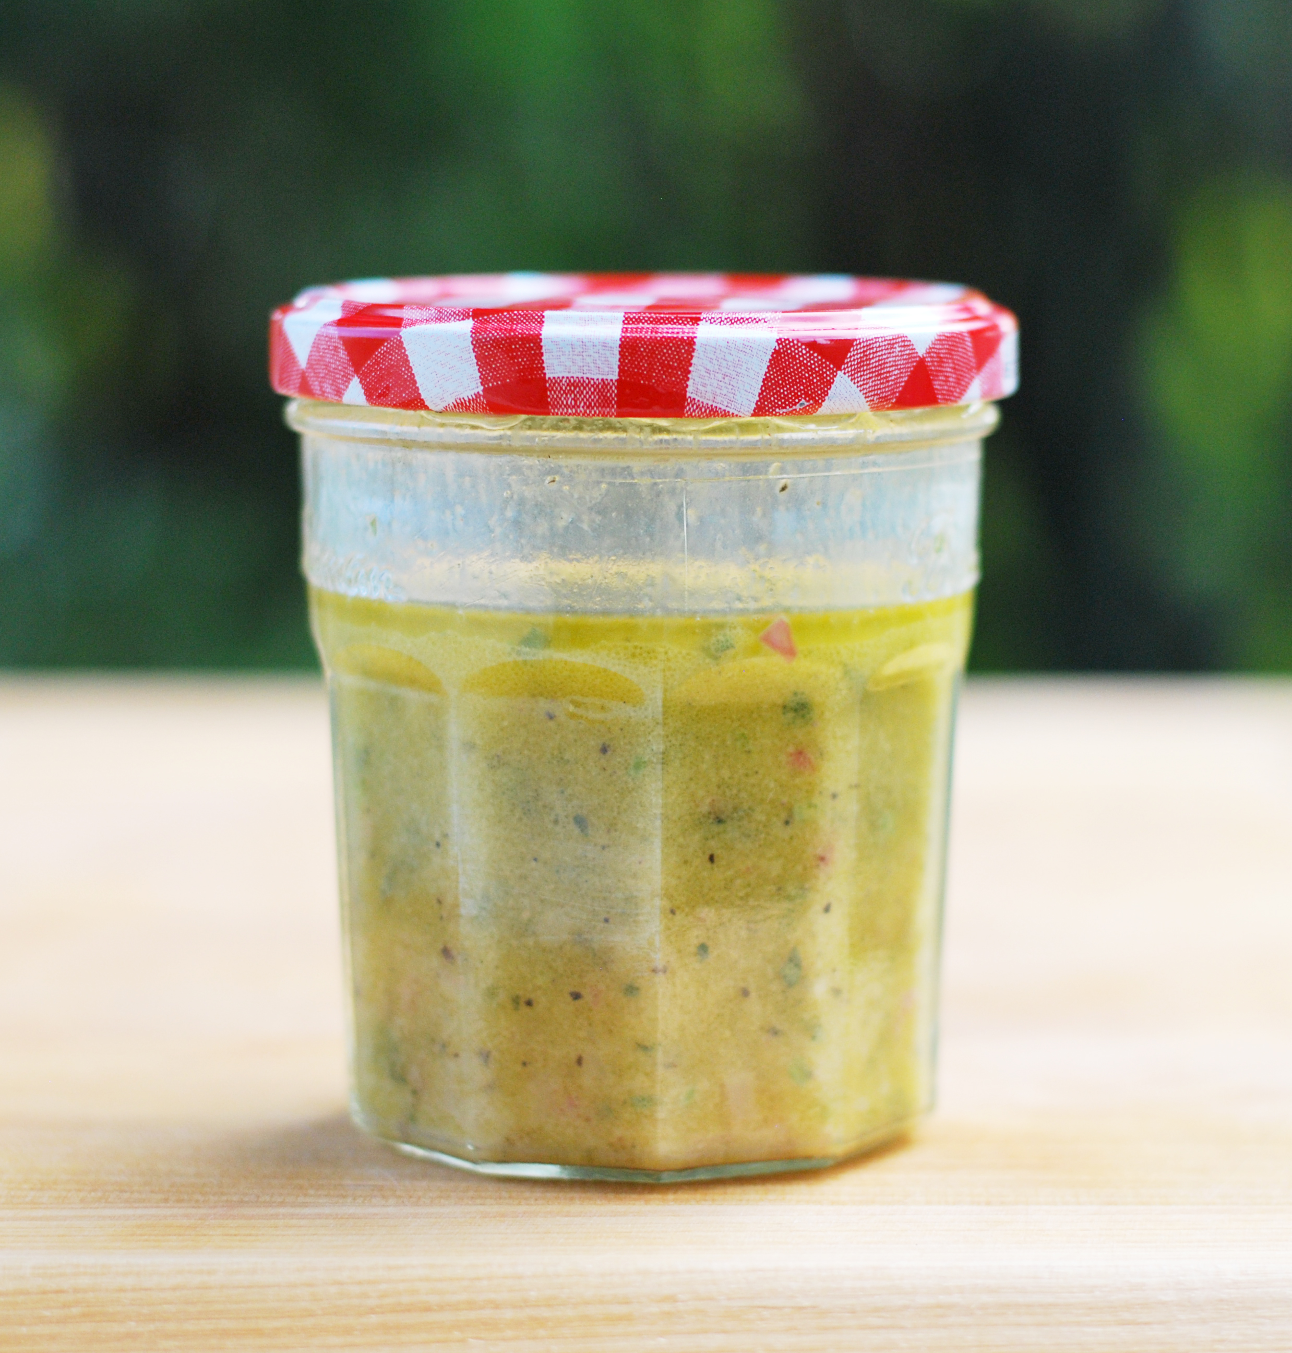
Heterogeneous Mixtures
Heterogeneous Mixtures (suspensions) are unevenly mixed
They are usually cloudy and full of flakes, specks or grains.
Examples: mud, gravel, concrete, salad dressing

Slide 18
Definition of a Solution
“A solution is a homogeneous mixture in which it is impossible to distinguish its constituent parts, even with an optical microscope”.
Solutions can exist as solids, liquids or gases forms:
Air = nitrogen_{(gas)} + oxygen_{(gas)} + other gases
Soda Water = water_{(liquid)} + CO_{2(gas)}
Wine = water_{(liquid)} + alcohol_{(liquid)} + flavours
Salt water = water_{(liquid)} + salt_{(solid)}
Steel = iron_{(solid)} + carbon _{(solid)}
Solution
Solvent
Solutes
Gaseous solution
Liquid solutions
Solid solution

Slide 19
AQUEOUS SOLUTIONS
The most important type of homogeneous mixture is the aqueous solution.
Aqueous solution means “solvent is water”
An aqueous solution consists of…
Solute(s): the material(s) that is/are dissolved.
The solvent: the liquid water that the solute(s) is/are dissolved in.
Solvent
Solution
Solute

Slide 20
Properties of Solutions
Concentration:
Concentration is the quantity of solute in a given amount of solution.
Concentration can be expressed a variety of ways:
Grams of solute per litre of solution (g/L)
Grams of solute per 100 mL of solution (% ^{m}/_{V})
Millilitres of solute per 100 mL of solution (% ^{V}/_{V})
Grams of solute per 100grams of solution (% ^{m}/_{m})
“Moles” of solute per litre of solution (mol/L or M.)

Slide 21
Concentration Formula
The formula for calculating concentration in grams per litre (the most common way we will express it) is:
Where:
C= concentration in g/L
m = mass of solute in grams
V = volume of solution in Litres.

Slide 22
Dilution
A concentrated solution can be made “weaker” by adding more solvent. This is called dilution.
“Dilution is a laboratory technique that involves decreasing the concentration of a solution by adding solvent.”
Definition of Dilution

Slide 23
The Dilution Formula
The formula for calculating dilution is:
C₁ V₁ = C₂ V₂
Where:
C₁ is the initial concentration (or concentration before dilution)
V₁ is the initial volume (or volume before dilution)
C₂ is the final concentration (or concentration after dilution)
V₂ is the volume after dilution (or volume after dilution)

Slide 24
Solubility
“Solubility is the maximum amount of solute that can be dissolved in a given amount of solvent”.
A saturated solution contains exactly the maximum amount of solute that can be dissolved in it.
An unsaturated solution contains less than the maximum amount
A supersaturated solution contains more than the maximum amount. Supersaturated solutions are made by heating a solute into solution and cooling.
Solubility can be expressed in the same units as concentration.

Slide 25
Lesson 1.3 PURE SUBSTANCES
A pure substance contains only one type of particle, once it has been purified or cleaned.
Elements and Compounds are Pure Substances

Slide 26
A Pure substance is a type of matter.
A Pure substance is not a mixture.
Matter
Pure Substance
Element
Compound
Mixture
Heterogeneous
Homogeneous
Pure substances include Elements and compounds.

Slide 27
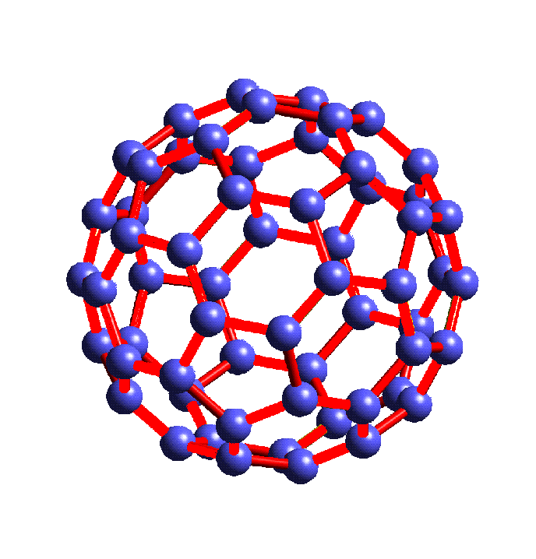
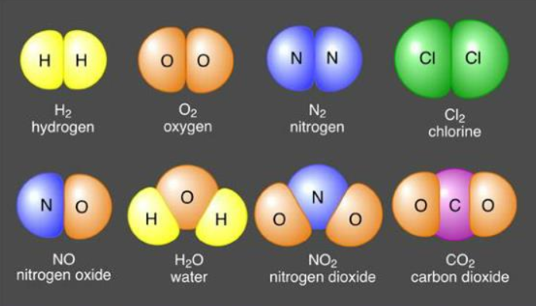
Elements vs Compounds
Only compounds and elements can be called PURE substances
An Element
Can be made of individual atoms, or of molecules that have only 1 type of atom (ie. All the atoms in the molecule are the same)
A Compound
Its molecules must be made from at least 2 types of atom or element
Au
One atom

Slide 28
ELEMENTS
An ELEMENT is a pure substance that contains only one type of atom.
It is impossible to separate an element into other substances using chemical separation techniques
That’s because there are no other substances to separate it into… it only has one type of atom!
A popular visualizations of all 118 elements that exist is represented using the “period table of elements.”

Slide 29
How Many Elements are There?
It depends on how you calculate it…
Periodic tables will show between 100 and 118 different elements
88 elements make up most of the universe.
94 elements exist naturally on Earth.
Including 6 that exist in only trace amounts
112 elements have been named.
Including 18 more that can only be produced artificially using nuclear reactions (very scarce)
118 elements have been detected.
Including six more that disintegrate so fast that we cannot study them. They have temporary designations instead of names.

Slide 30
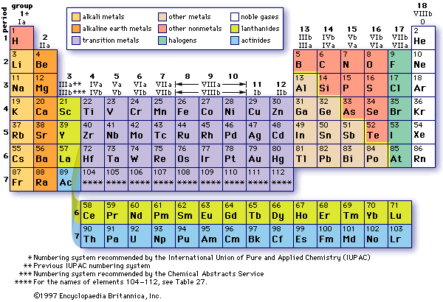
Periodic Table - The Elements
Non-metal
Elements
Metallic Elements
More Metallic Elements

Slide 31
Information from the Periodic Table
11
Na
Sodium
23.0
Atomic Number
(# of protons)
Sodium has 11 protons.
Chemical Symbol
( abrev. of Latin name)
Eg. The Latin name of sodium is Natrium
Element Name
(English name)
Atomic Mass (weight)
(approx. # of protons + neutrons)
Sodium always has 11 protons, and usually 12 neutrons.
Metals
Non-metals
Li
← Element is normally a solid metal
Ne
← Element is normally a gas and a Non-metal
Br
← Element is normally a liquid and a Non-metal
Pu
← Element is a synthetic metal (not found in nature)

Slide 32
A Few Elements by Name (with formula and particle— atom or molecule – shown)
Hydrogen H₂ Silicon Si Germanium Ge
Helium He Phosphorus P₄ Arsenic As
Lithium Li Sulphur S₈ Selenium Se
Beryllium Be Chlorine Cl₂ Bromine Br₂
Boron B Argon Ar Krypton Kr
Carbon C Potassium K Silver Ag
Nitrogen N₂ Calcium Ca Gold Au
Oxygen O₂ Chromium Cr Platinum Pt
Fluorine F₂ Iron Fe Lead Pb
Neon Ne Cobalt Co Mercury Hg
Sodium Na Nickel Ni Uranium U
Magnesium Mg Zinc Zn Plutonium Pu
Aluminum Al Copper Cu
Si
Ge
P
As
Li
S
Se
Be
Br
Cl
Br
B
Ar
Kr
C
K
Ag
N
Ca
Au
Cr
Pt
O
Fe
Pb
F
Co
Hg
Na
Ni
U
Zn
Pu
Al
Cu

Slide 33
COMPOUNDS
A COMPOUND is a pure substance that contains two or more types of atoms that are chemically combined (ie. tightly bonded together).
It is possible to separate compounds into elements, but only by using chemical separation techniques (eg. electrolysis, reduction)
There are thousands of different compounds known to exist.

Slide 34
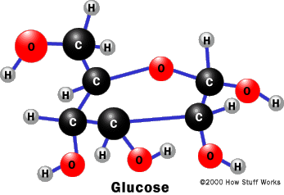
Some Common Compounds with formulas and diagrams of their molecules
Water (H₂O) Baking Soda (NaHCO₃)
Salt (NaCl) Vinegar (CH₃COOH)
Alcohol (C₂H₅OH) Sugar (C₁₂H₂₂O₁₁)
Methane (CH₄)
Ammonia (NH₃)
Carbon dioxide (CO₂)
H
Na
O
H
C
H
O
Na
Cl
H
C
C
H
H
O
H
C
C
o
H
H
H
H
H
C
H
H
H
H
N
H
O
C
O

Slide 35
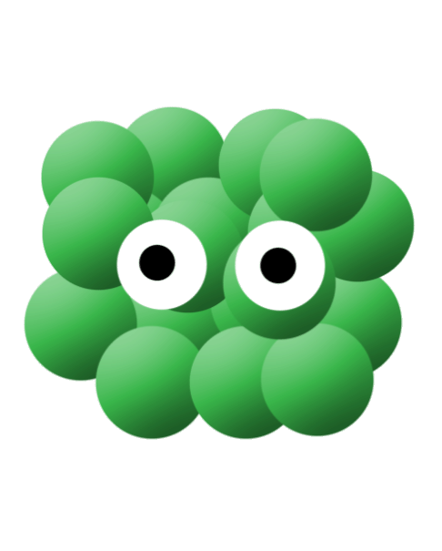
A Molecule

Slide 36
Why are Compounds Called “Pure”?
Because they can be purified.
When purified all their molecules are the same.
Pure
Pure
Mixture
H
H
O
H
O
H
H
O
H
All particles the same
All particles the same
Two different particle types

Slide 37
Characteristic Properties
“A Characteristic property is one that helps us identify a pure substance, or a group to which the pure substance belongs”.
The concept of characteristic properties applies mainly to pure substances, ie. Elements & compounds, although chemical properties may show constituents.
Characteristic properties are of two types
Characteristic Physical Properties (pure substances only)
Characteristic Chemical Properties (possible constituents)
Non-characteristic properties are ones that are not much help in identifying what a pure substance is, or what it is made of.

Slide 38
Examples of Physical Characteristic Properties
Physical Property | Description | Examples
Melting Point (or Freezing Point) | Temperature at which a solid becomes a liquid (vice versa), expressed in °C | Water: 0°C Ethanol: -117°C Salt: 801°C
Boiling Point (or Condensation Point) | Temperature at which a liquid becomes a gas (vice versa) expressed in °C | Water: 100°C Ethanol: 79°C Salt: 1465°C
Density | The mass per unit of volume, expressed in g/mL | Water : 1.0 g/mL Ethanol: 0.79 g/mL Gold: 1 9.3 g/mL
Solubility | The maximum amount of solute that can be dissolved in a given amount of solvent. Can be expressed in g/L or %^{m}/_{V}, %^{V}/_{V}, %^{m}/_{m} | Salt* 357 g/L CO₂* 3.48 g/L Sugar* 1792 g/L * Dissolved in water

Slide 39
Characteristic vs. Non-characteristic
Mass is a non-characteristic property.
Why? Because a material can have any mass. You could have a kilogram of lead, or a kilogram of water, or a kilogram of Styrofoam. The amount of material does not help identify it.
Volume is a non-characteristic property.
Why? You could have a litre of water or a litre of alcohol or a litre of gasoline. A material can have any volume.
Density, calculated from mass and volume, is a characteristic property
Why? Because each different substance has its own density. You can use density to help identify a substance.

Slide 40
Examples of chemical Properties
Chemical Property | Indications | Changes
Reaction of Litmus Paper | Indicates if the substance is an acid or a base | Turns Red = Acid (pH<7) Turns Blue=Base (pH>7) No change = neutral (pH7)
Reaction of Cobalt Chloride paper. | Indicates if the substance contains water | Turns pink, white or greenish = substance contains some water
Reaction of Limewater (to a gas) | Indicates if the substance contains carbon dioxide | Turns milky = contains some CO₂
Reaction of Glowing wooden splint (to a gas) | Indicates if the substance supports combustion (usually oxygen) | Splint reignites = contains substance that supports combustion (eg. Oxygen)
Reaction of a burning wooden splint (to a gas) | Indicates an explosive gas (usually hydrogen) | If a “pop” or small explosion occurs, there is an explosive gas
Reaction to an open flame | The colour of the flame may indicate certain substances. | Purple = potassium Green = barium or copper Red = strontium

