Slide 1
1.01 Rearranging Linear Inequalities
Unit: Optimization

Slide 2
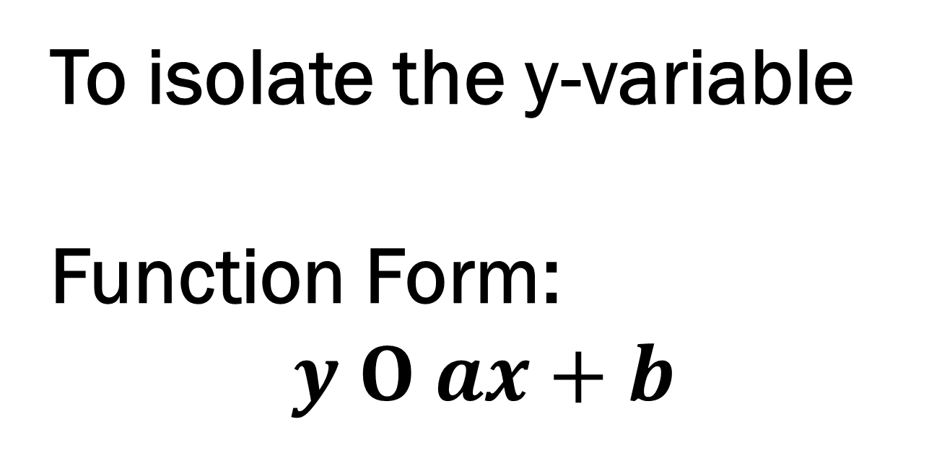
Goal
To isolate the y-variable
Function Form:
$$y Ο ax+b$$

Slide 3
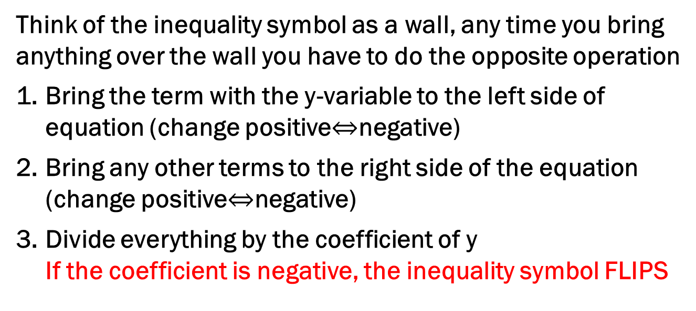
How To:
Think of the inequality symbol as a wall, any time you bring anything over the wall you have to do the opposite operation
Bring the term with the y-variable to the left side of equation (change positive$⇔$negative)
Bring any other terms to the right side of the equation (change positive$⇔$negative)
Divide everything by the coefficient of y If the coefficient is negative, the inequality symbol FLIPS

Slide 4
Practice!!
Practice!!
Practice!!
☺

Slide 5
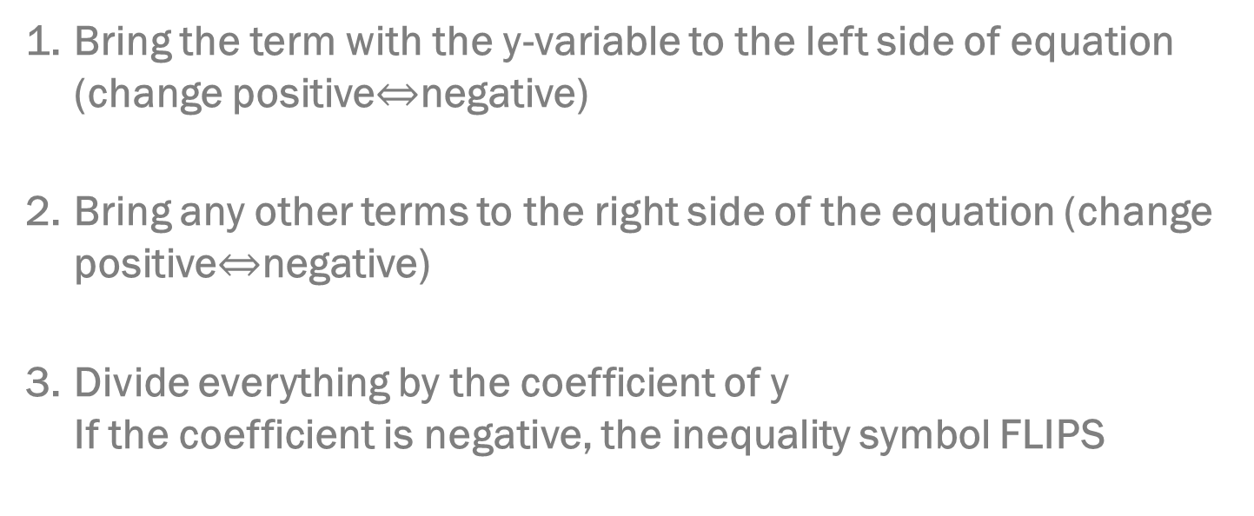
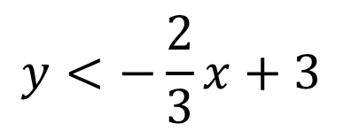

$$2x+3y−9<0$$
Bring the term with the y-variable to the left side of equation (change positive$⇔$negative)
Bring any other terms to the right side of the equation (change positive$⇔$negative)
Divide everything by the coefficient of y If the coefficient is negative, the inequality symbol FLIPS
$$3y<−2x+9$$
$$\frac{3y}{3}<\frac{−2x+9}{3}$$
$$y<−\frac{2}{3}x+3$$

Slide 6
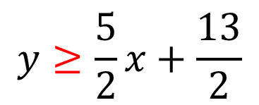
$$5x−2y+13≤0$$
Bring the term with the y-variable to the left side of equation (change positive$⇔$negative)
Bring any other terms to the right side of the equation (change positive$⇔$negative)
Divide everything by the coefficient of y If the coefficient is negative, the inequality symbol FLIPS
$$−2y≤−5x−13$$
$$\frac{−2y}{−2}≤\frac{−5x−13}{−2}$$
$$y≥\frac{5}{2}x+\frac{13}{2}$$

Slide 7
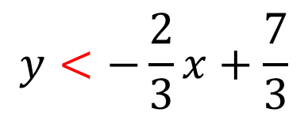

$$7−2x>3y$$
Bring the term with the y-variable to the left side of equation (change positive$⇔$negative)
Bring any other terms to the right side of the equation (change positive$⇔$negative)
Divide everything by the coefficient of y If the coefficient is negative, the inequality symbol FLIPS
$$7−2x−3y>0$$
$$−3y>2x−7$$
$$\frac{−3y}{−3}>\frac{2x−7}{−3}$$
$$y<−\frac{2}{3}x+\frac{7}{3}$$

Slide 8
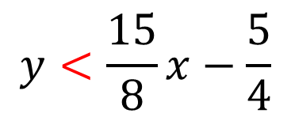
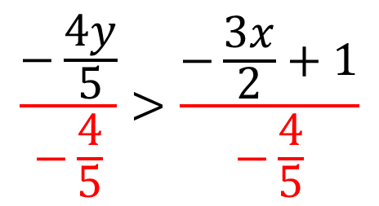
$$\frac{3x}{2}−\frac{4y}{5}>1$$
Bring the term with the y-variable to the left side of equation (change positive$⇔$negative)
Bring any other terms to the right side of the equation (change positive$⇔$negative)
Divide everything by the coefficient of y If the coefficient is negative, the inequality symbol FLIPS
$$−\frac{4y}{5}>−\frac{3x}{2}+1$$
$$\frac{−\frac{4y}{5}}{−\frac{4}{5}}>\frac{−\frac{3x}{2}+1}{−\frac{4}{5}}$$
$$y<\frac{15}{8}x−\frac{5}{4}$$

Slide 9
Practice
HANDOUT
Also required Graphing – yesterday ☺

